Slide 1
Complaint Text Categorization using different topic modelling approaches (LDA, BERT)
October 26, 2020

Slide 2
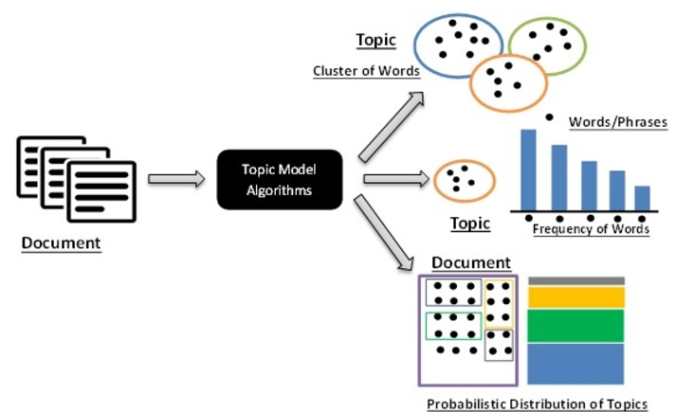
Topic Modeling on customer complaints text
Business Case
Customer centric business, it is very much required to ensure they are acting in their customers’ best interest, which includes the way in which they address their customer complaints. Text mining and topic modeling techniques are involved to examine unstructured text present within the complaints texts and to classify them under most frequent and meaningful topics through unsupervised methods. Topic modeling in complaints text can help business to understand what the frequently occurring customer dissatisfaction areas are and where improvement in customer servicing will increase business outcome and customer satisfaction. At call centres, agent manually assign category/topic as per customer issue. There remain chances of misassignment of Complain/Issue category. Here our work is to automate this category assignment.
Solution
Topic modeling is an unsupervised machine learning approach that identifies 'themes' within text data Here we have build a topic model on sample complaint text of “Mortgage” product (Data source: CFPB). Then we run different unsupervised topic modelling approaches (kMeans, LDA on both TFIDF & BERT vectors), at first to define total optimal no of complaint category and then assign the most suitable issue category to the new complain text in “Morgage” product. LDA(Latent Dirichlet Allocation) is a topic modeling algorithm that has been included in gensim. It classify text in a document to a particular topic. It builds a topic per document model and words per topic model, modeled as Dirichlet distributions. BERT sentence embedding model embed text into a vector space where the vectors capture the contextual meaning of sentences.
Benefits
Customer negative feedback/complaint data is categorized and convened into countable topics and servicing areas that can be easily comprehended by business and complaint management team. Gain valuable insights on the historic trend of issues occurring in customer servicing/support activities. Categorization and segmentation of topic are detected through unsupervised and help business to take more active decision for a particular segment. Trends can be derived, which segment of topic is trending over a time. Identify fragments, where more keen decision can be taken. More effective management decision can be taken and weak areas can be identify.

Slide 3
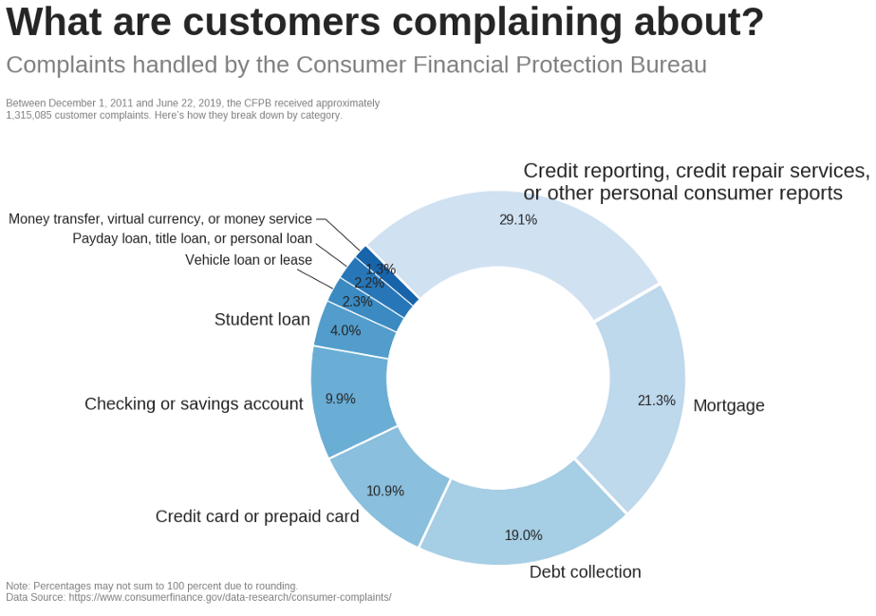
CFPB(Consumer Financial Protection Bureau) database
CFPB publishes data on consumer complaints about financial products and services. This data is captured either after the company responds to the complaint, or after 15 days.
Product | count | mean | std | min | 25% | 50% | 75% | max
Debt collection | 47,915 | 815 | 829 | 5 | 301 | 557 | 1,027 | 25,491
Mortgage | 36,582 | 1,470 | 1,154 | 13 | 622 | 1,129 | 2,033 | 31,369
Credit reporting | 31,592 | 750 | 721 | 11 | 275 | 509 | 960 | 4,171
Credit card | 18,842 | 1,126 | 895 | 14 | 481 | 861 | 1,503 | 4,029
Bank account or service | 14,888 | 1,243 | 954 | 9 | 533 | 954 | 1,683 | 5,151
Credit reporting, credit repair services, or other personal consumer reports | 14,671 | 868 | 947 | 12 | 338 | 621 | 1,083 | 21,112
Student loan | 13,304 | 1,183 | 1,001 | 6 | 497 | 890 | 1,554 | 17,604
Consumer Loan | 9,474 | 1,108 | 911 | 18 | 437 | 821 | 1,496 | 4,045
Source: Kaggle.com

Slide 4
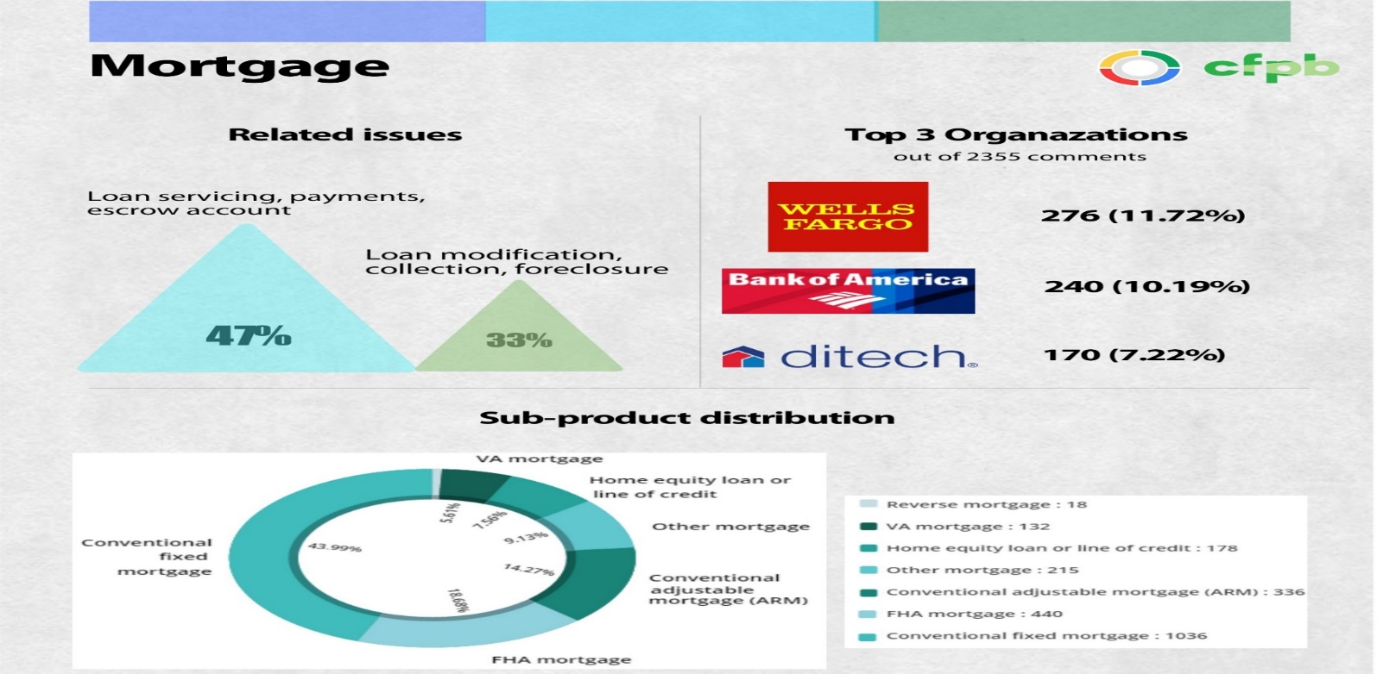
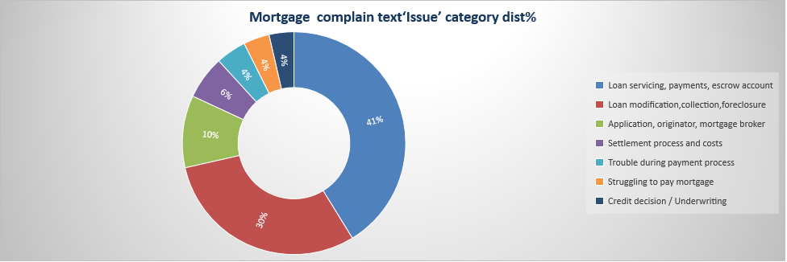
Mortgage Complaint Text descriptive statistics
**Sources: Kaggle.com

Slide 5
Our Approaches
1
Data Cleaning
Remove punctuation and lower case the text
Remove Stop words and special characters from the notes.
Remove Unicode, URL, @User, Hashtag, numbers, special characters, multiple exclamation mark, multiple full stop, multiple question mark, multiple stop mark and multiple commas.
Remove incomplete words, System words and names
Using Stemming process, transform a word into its stem (normalized form).
6
Hyperparameter Tuning:
Perform a series of sensitivity tests to help determine the following model hyperparameters:
Number of Topics (K)
Dirichlet hyperparameter(α): Document-Topic Density
Dirichlet hyperparameter(β): Word-Topic Density
Final Model
Based on Coherence score,(C_v), first determine the optimal number of topics, with fixed α=0.1 & β=0.1, next determine optimal values for α & β. Elbow method to outlines the C_v.
5
2
Phrase Modeling
Bi-grams and Tri-grams
Loading Data
Data Transformation
TF-IDF Vectorizer: “Term Frequency-Inverse Document Frequency”: Calculate the weight of each word signifies the importance of the word in the document and corpus.
Data Transformation
BERT: Embedding models to embed reviews into a vector space where the vectors capture the contextual meaning of sentences.
3
Hyperparameter Tuning:
Perform a series of sensitivity tests to help determine the following model hyperparameters:
Number of Topics (K)
Topic Modelling
Approaches
Approach 1
Approach 2
Approach 3
Approach 4
Identify text similarity structure in the TF-IDF vector space by clustering methods( K-Means).
LDA: find latent variables (topics) in a large set of observable variables (words in a corpus). It represents documents as mixtures of topics that spit out words with certain probabilities.
Identify text similarity structure in the TF-IDF vector space by clustering methods( K-Means).
Probabilistic topic assignment vector by LDA
Sentence embedding vector by BERT
Concatenated these two vectors in a high-dimensional space, where information is sparse and correlated, used an autoencoder to learn a lower dimensional latent space representation of the concatenated vector.
4
Topic 1
Topic 2
Topic N
7
Visualize Topics
LDA clusters can be visualized with top keywords and prevalence score using pyLDAvis genism package. LDA output “keywords” column provides the keywords for individual clusters. Each document(text) might be having one or multiple keywords from the cluster keywords.
TF-IDF + Clustering
LDA
BERT + Clustering
BERT + LDA

Slide 6
Result Comparison
Evaluation | Approaches
Metric/Method | TF-IDF + Clustering | LDA | BERT + Clustering | BERT + LDA
Coherence Value | 0.266975732 | 0.301286374 | 0.395795941 | 0.436755
Silhouette score | 0.008472792 | 0.101698765 | 0.030916205 | 0.15714453

Slide 7
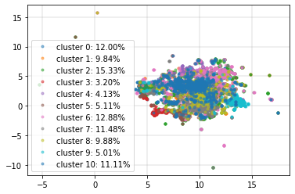
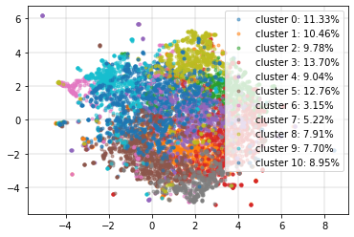
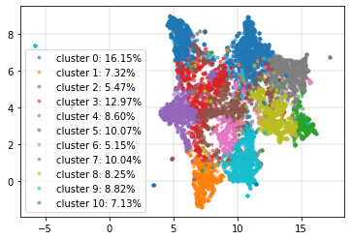
Clustering Results
TF-IDF RESULTS CLUSTERS
LDA RESULTS CLUSTERS
BERT+LDA RESULTS CLUSTERS

Slide 8
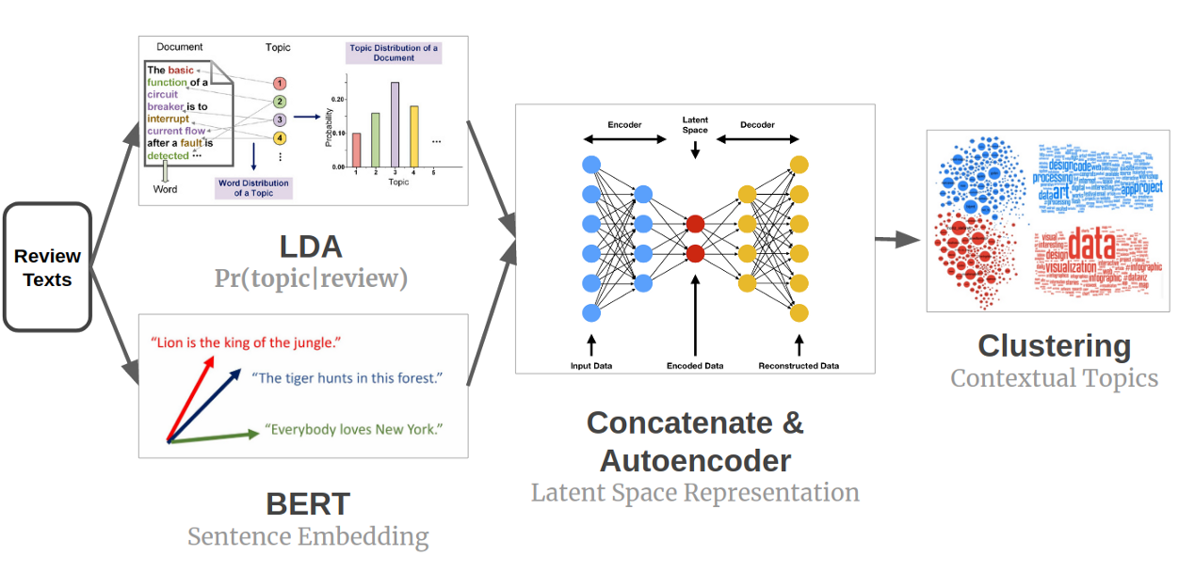
BERT + LDA
LDA or TF-IDF is effective for identifying topics by finding frequent words when texts are coherent within themselves. On the other hand, when texts are incoherent (in terms of word choice or sentence meaning), extra contextual information is needed to comprehensively represent the idea of the texts.
By combining LDA, BERT, and clustering, we can keep the semantic information and create Contextual Topic Identification. Below is the result, where clusters are balanced and quite separated.

Slide 9
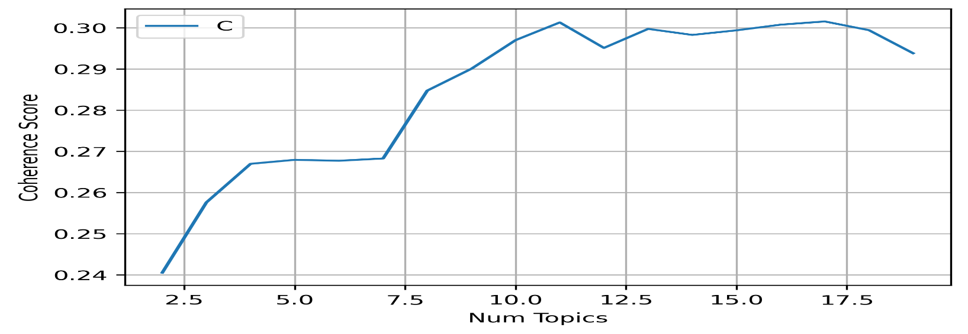
LDA+BERT (contd..)
LDA hyperparameter tuning output for various n_topics.
For α=0.3 β=0.9 & n_topic=11 we are getting high Coherence score
LDA output topics distribution vs actual source issue category

Slide 10
LDA Cluster Output
Mortgage Complaint Text Issue Type | LDA_Topic_1 | LDA_Topic_2 | LDA_Topic_11 | LDA_Topic_3 | LDA_Topic_4 | LDA_Topic_5 | LDA_Topic_6 | LDA_Topic_7 | LDA_Topic_8 | LDA_Topic_9 | LDA_Topic_10 | Grand Total
Application, originator, mortgage broker |  | 495 | 223 |  |  |  |  |  |  |  |  | 718
Collection |  |  |  | 681 |  |  |  | 433 |  |  |  | 1,114
Credit decision / Underwriting |  | 571 |  |  |  | 287 | 207 |  |  |  |  | 1,065
Escrow account |  |  | 812 |  |  | 751 |  | 476 | 474 |  |  | 2,513
Foreclosure | 520 |  |  |  |  |  | 521 |  |  |  |  | 1,041
Loan modification |  |  |  |  | 321 |  |  |  | 318 | 416 | 186 | 1,241
Loan servicing | 808 |  |  | 931 |  |  |  |  |  | 471 | 275 | 2,485
Payments |  |  |  |  | 350 |  | 597 |  |  |  |  | 947
Settlement process and costs |  | 198 | 187 |  |  |  |  |  |  |  |  | 385
Struggling to pay mortgage |  |  |  |  |  | 48 |  |  | 39 |  |  | 87
Trouble during payment process | 73 |  |  |  |  | 52 |  | 25 | 34 |  |  | 184
Grand Total | 1,401 | 1,264 | 1,222 | 1,612 | 671 | 1,138 | 1,325 | 934 | 865 | 887 | 461 | 11,780

Slide 11
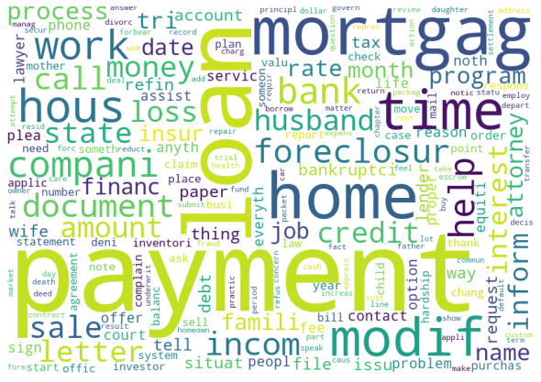
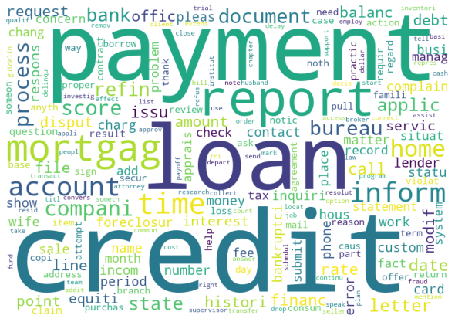
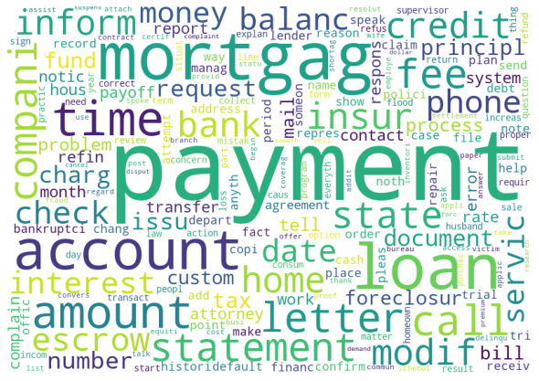
BERT + LDA (Story from cluster word clouds)
Cluster 1
Most frequent keywords are 'Loan' 'Help' 'Service' 'Call' 'Statement' which derived it as 'Loan Servicing' & ‘Foreclosure' 'Refinance' 'Inform' derives it as ‘Foreclosure' issue category
Cluster 2
Most frequent keywords are 'Account' 'Mortgage' which derived it as 'Application Originator Mortgage broker' & 'Credit' 'Report' derives it as 'Credit decision / Underwriting' issue category.
Cluster 3
Most frequent keywords are 'Payment' 'Time' 'Statement', 'Money', 'Balance', 'Amount', 'Bill' which derived it as 'Payment' & 'Loan' 'Modification' 'Letter' ,'Bill', ‘Foreclosure', 'Document', 'Charge', 'Refinance', 'Fee' derives it as 'Loan Modification' issue category

Slide 12
BERT + LDA (Story from cluster word clouds) contd..
Cluster 1
Most frequent keywords are 'Loan' 'Help' 'Service' 'Call' 'Statement' which derived it as 'Loan Servicing' & 'Forclosure' 'Refinance' 'Inform' derives it as 'Forclosure' issue category
Cluster 2
Most frequent keywords are 'Account' 'Mortgage' which derived it as 'Application Originator Mortgage broker' & 'Credit' 'Report' derives it as 'Credit decision / Underwriting' issue category
Cluster 3
Most frequent keywords are 'Payment' 'Time' 'Statement', 'Money', 'Balance', 'Amount', 'Bill' which derived it as 'Payment' & 'Loan' 'Modification' 'Letter' ,'Bill', 'Forclosure', 'Document', 'Charge', 'Refinance', 'Fee' derives it as 'Loan Modification' issue category

Slide 13
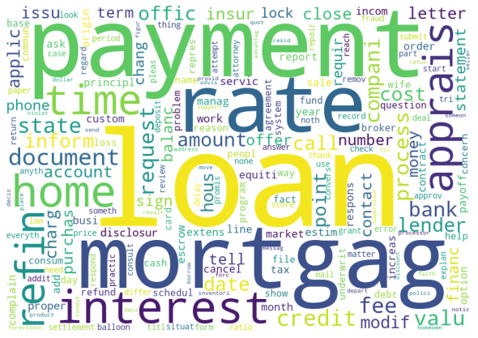
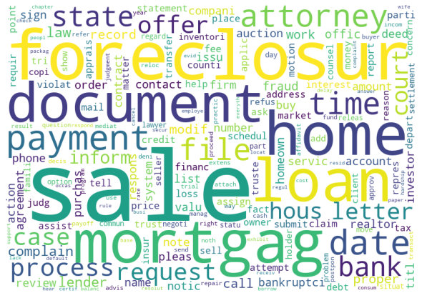
BERT + LDA (Story from cluster word clouds) contd..
Cluster 10
Most frequent keywords are 'Loan' 'rate', 'interest', 'home', 'state’, 'amount', 'Money', 'time', 'term', 'number', 'bank', 'mortgage’, 'document', 'lender' which derived it as 'Loan servicing' issue category
Cluster 9
Most frequent keywords are ‘Sale’, ‘document’, ‘mortgage’, ‘loan', ‘time’, ‘foreclosure', ‘state’, ‘attorney’, ‘letter', ‘process', ‘request', ‘offer’ which derived it as 'Escrow account' issue category

Slide 14
To Do(Scope for improvement)
For such type of big document text(containing mixture keywords from multiple topics), it is hard to assign any particular target topic by any unsupervised technique. To improve topic modelling process, in input we can apply advanced ‘Text Summarize’ approach to reduce the input text length and mixed context words.
Using advanced ‘Sentiment Analysis’ technique we can filter out non-complain text in input.

Slide 15
Appendix

Slide 16
Data Preprocessing(Stop-words)
Stop-words are those words from non-linguistic view which do not carry information
…they have mainly functional role
…we have removed them to help the methods to perform better
Natural language dependent – examples:
English: A, ABOUT, ABOVE, ACROSS, AFTER, AGAIN, AGAINST, ALL, ALMOST, ALONE, ALONG, ALREADY, ALSO, ...

Slide 17
Stemming & Lemmatization
Different forms of the same word are usually problematic for text data analysis, because they have different spelling and similar meaning (e.g. learns, learned, learning,…)
Stemming is a process of transforming a word into its stem (normalized form)
Lemmatization: The lemma (root word) has been identified from the individual tokens using NLTK wordnet lemmatizer based on the significance of the word (NLTK pos-tag) in the corresponding sentence.

Slide 18
Phrases in the form of frequent N-Grams
Simple way for generating phrases are frequent n-grams:
N-Gram is a sequence of n consecutive words (e.g. “machine learning” is 2-gram)
“Frequent n-grams” are the ones which appear in all observed documents MinFreq or more times.

Slide 19
LDA: A very simple example
Consider these 5 “documents”:
I like to eat broccoli and bananas.
I ate a banana and spinach smoothie for breakfast.
Chinchillas and kittens are cute.
My sister adopted a kitten yesterday.
Look at this cute hamster munching on a piece of broccoli.
If asked for 2 topics, LDA might produce:
Sentences 1 and 2: 100% Topic A
Sentences 3 and 4: 100% Topic B
Sentence 5: 60% Topic A, 40% Topic B
Topic A: 30% broccoli, 15% bananas, 10% breakfast, 10% munching, … (at which point, you could interpret topic A to be about food)
Topic B: 20% chinchillas, 20% kittens, 20% cute, 15% hamster, … (at which point, you could interpret topic B to be about cute animals)
Note: in order to do this, LDA assumes prior probability distribution and then iteratively generates topics using a bag-of-words representation

Slide 20
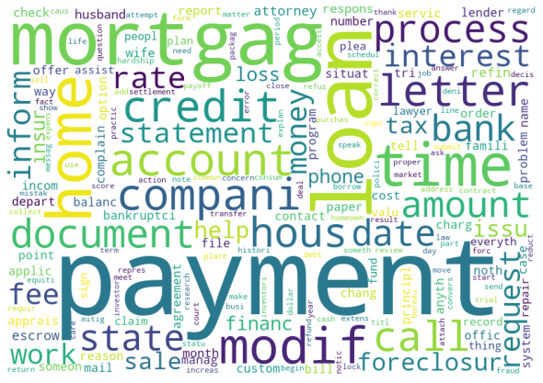
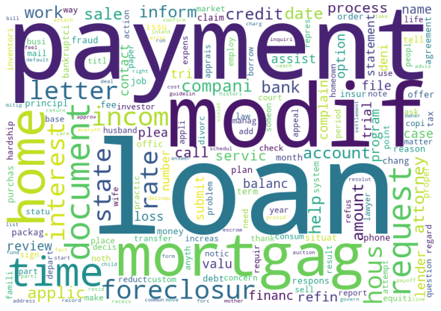
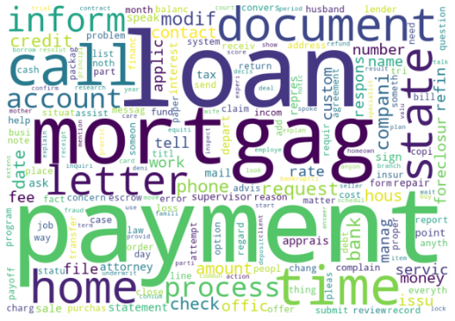
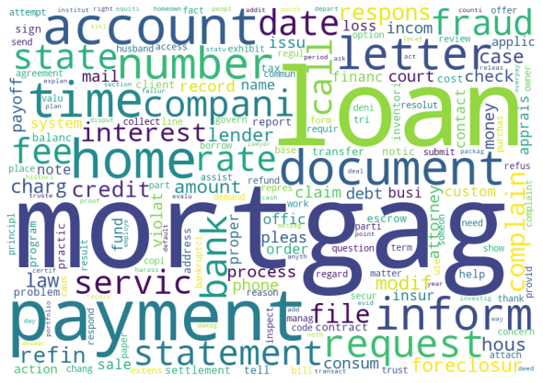
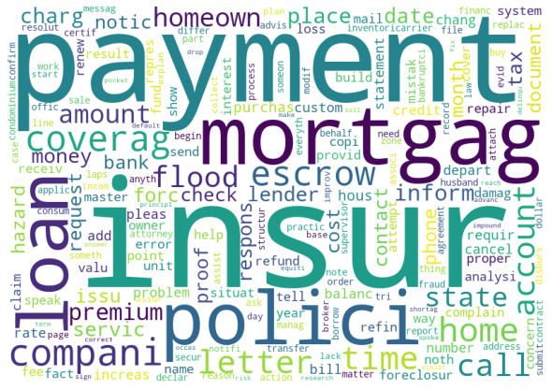
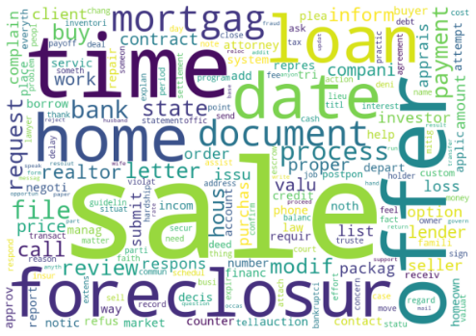
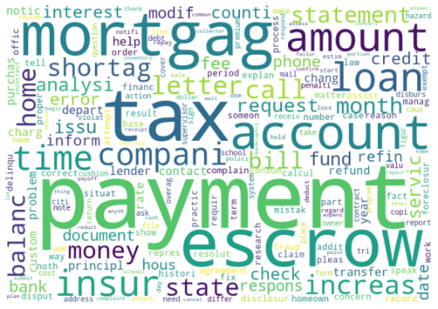
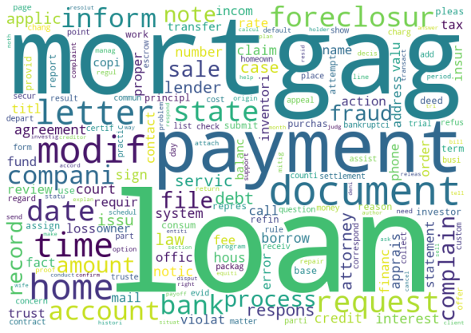
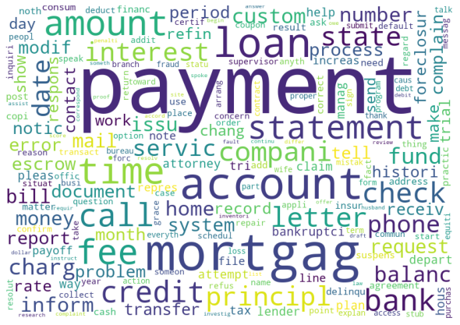
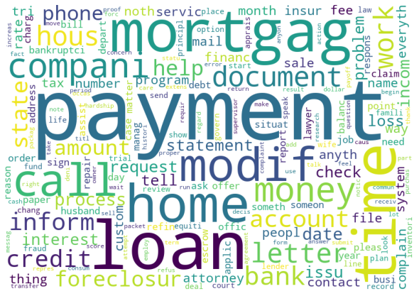
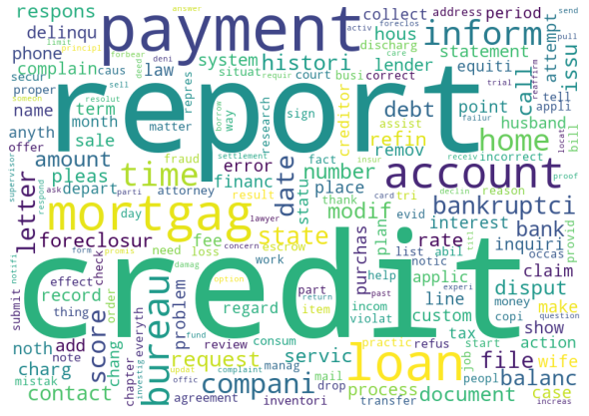
Approach 1: TF-IDF + Clustering
On transform data, we run unsupervised k-Means clustering with k=11 and got below topic clusters.
Cluster 1
Cluster 2
Cluster 11
Cluster 3
Cluster 4
Cluster 5
Cluster 6
Cluster 7
Cluster 8
Cluster 9
Cluster 10

Slide 21
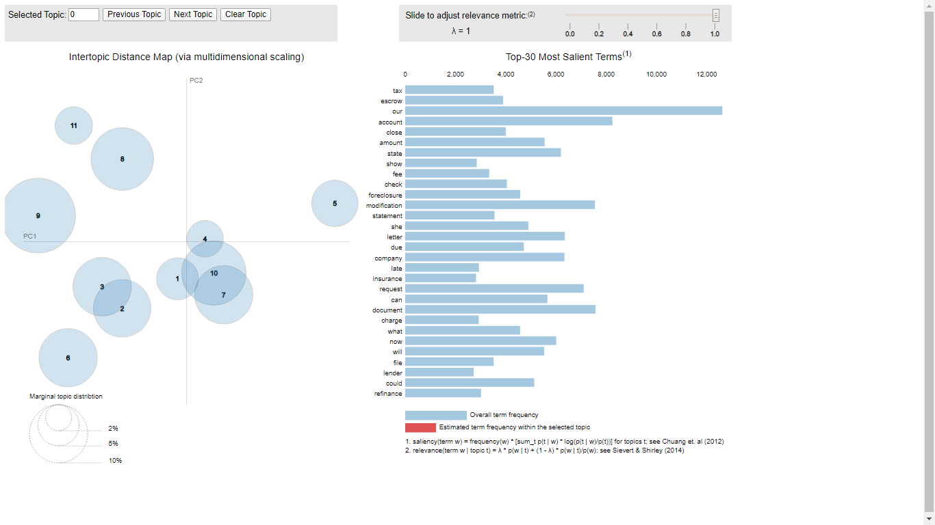
LDA Visualization(pyLDAvis package)

Slide 22
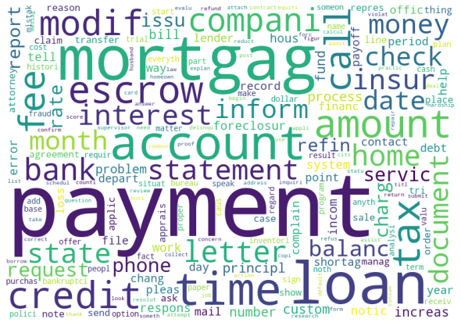
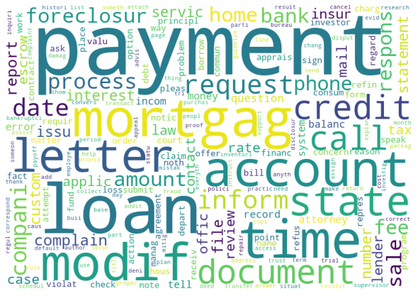
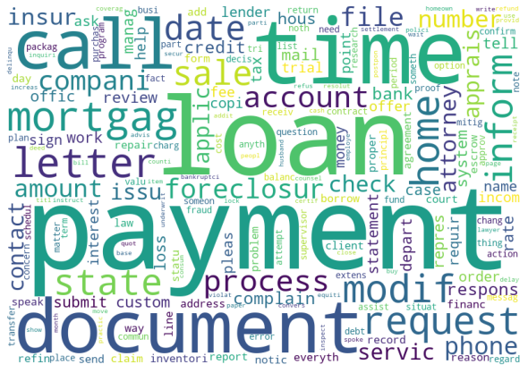
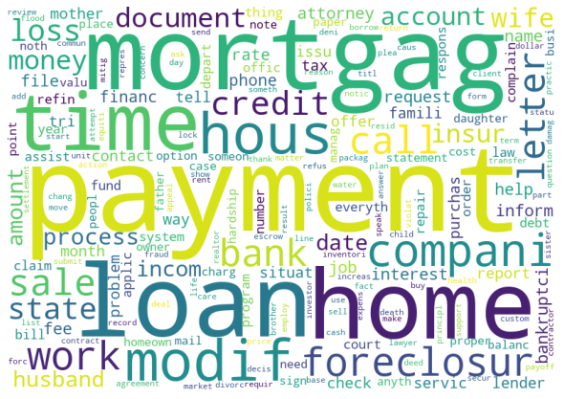
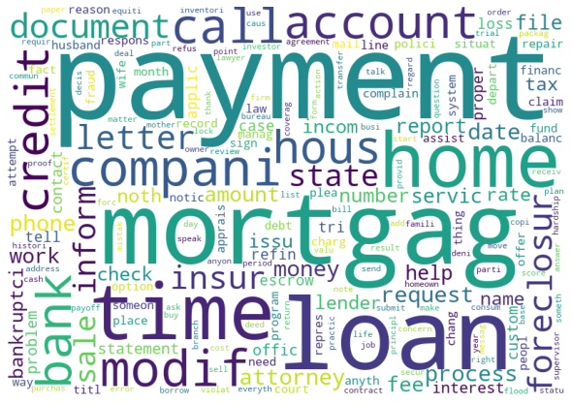
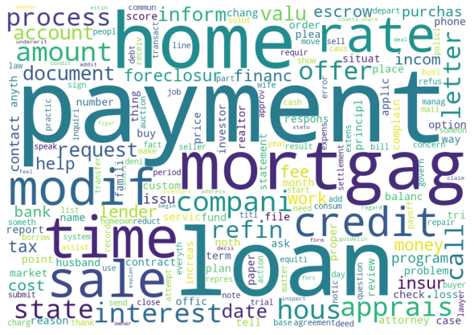
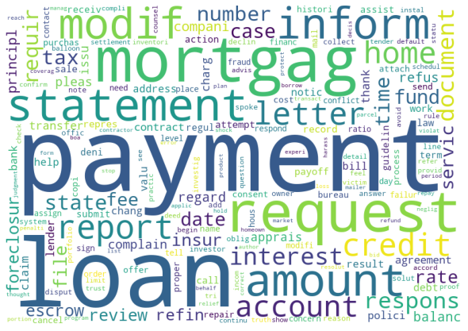
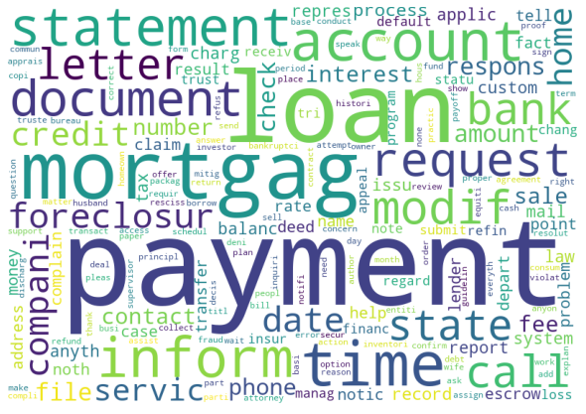
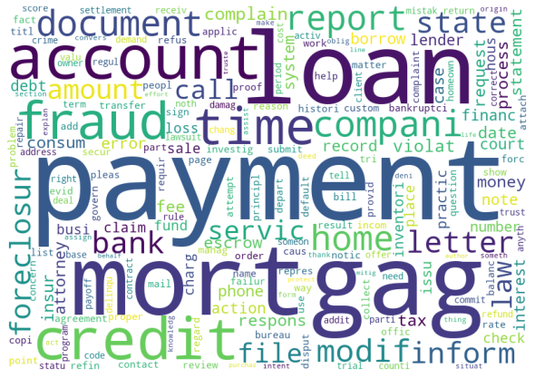
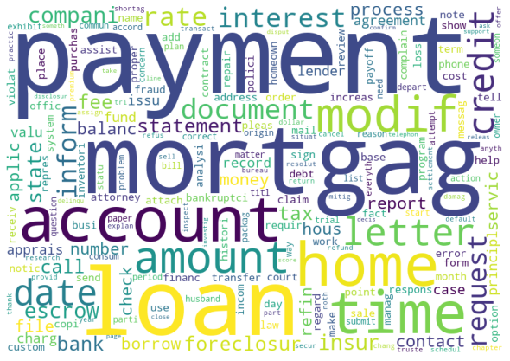
BERT + Clustering
Using sentence embedding models (BERT) to embed text into a vector space where the vectors capture the contextual meaning of sentences.
Cluster 1
Cluster 2
Cluster 3
Cluster 4
Cluster 5
Cluster 6
Cluster 7
Cluster 8
Cluster 9
Cluster 10
Cluster 11

Slide 23
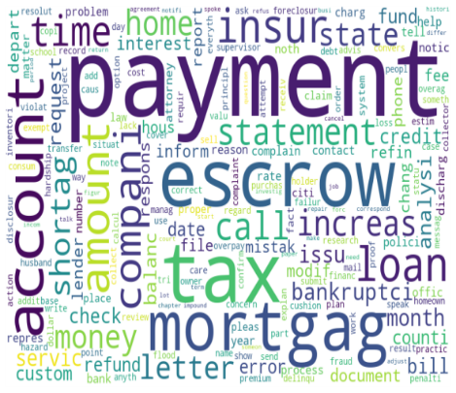
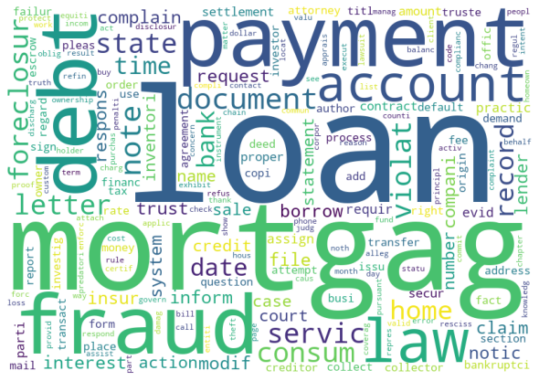
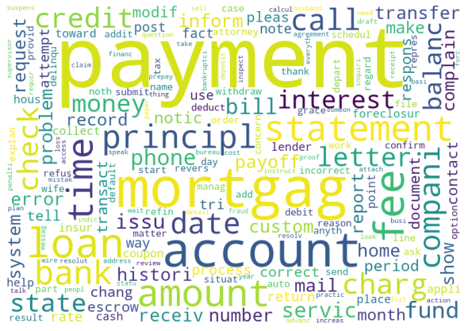
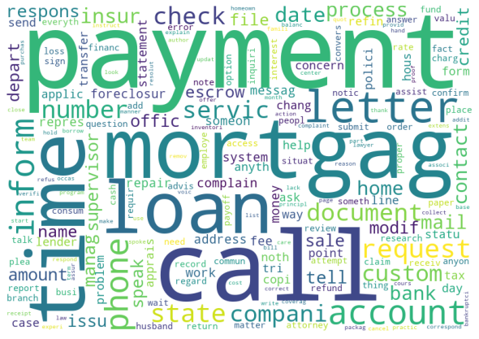
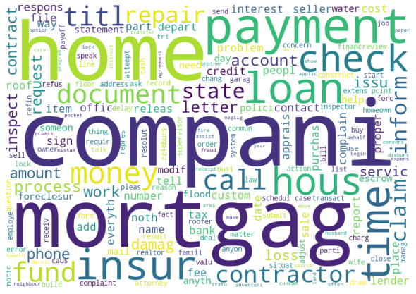
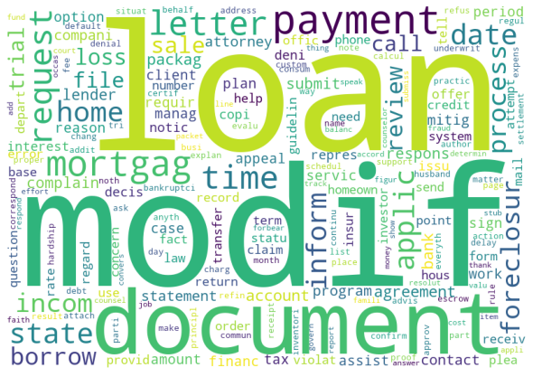
BERT + LDA (Output Clusters)
Cluster 1
Cluster 2
Cluster 11
Cluster 3
Cluster 4
Cluster 5
Cluster 6
Cluster 7
Cluster 8
Cluster 9
Cluster 10

